Slide 1

Machine learning based Buyer Segmentation and Investment Profiling for Real Estate Market Intelligence
Customer profiling, buyer segmentation, and property investment insights to support data-driven decision making.

Slide 2
1.Introduction
The real estate industry generates large amounts of customer and property data. Understanding buyer behaviour and investment preferences is important for making strategic business decisions. This project aims to analyse real estate buyers, identify different buyer segments, and study property investment patterns.

Slide 3
2.Problem
Different types of property buyers
Investment motivations across demographics
Geographic differences in investment behaviour
Customer financing patterns

Slide 4
2. Project Objectives
Analyse buyer demographics and behaviour.
Segment buyers into meaningful groups.
Study property investment patterns.
Analyse geographic distribution of buyers.
Develop interactive dashboards for business insights.
Generate actionable recommendations for real estate stakeholders.

Slide 5
3.Dataset overview
(a) Clients Dataset
Client ID
Client Type
Country
Region
Date of Birth
Acquisition Purpose
Loan Applied
Satisfaction Score
(b) Properties Dataset
Listing ID
Unit Category
Sale Price
Floor Area
Transaction Date
Listing Status
Client Reference

Slide 6
4.Data Cleaning
Removed duplicate records
Corrected date format inconsistencies
Created Age column from Date of Birth
Verified property prices and area values
Checked for missing values

Slide 7
5.Featuring Engineering
1.First-Time Buyers
2.Corporate Buyers
3.Luxury Investors
4.Global Investors

Slide 8
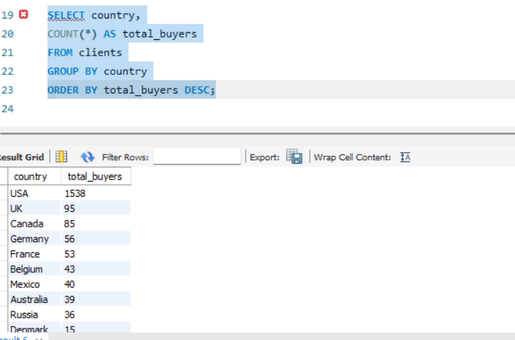
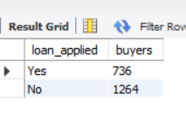
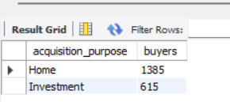
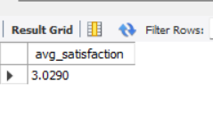
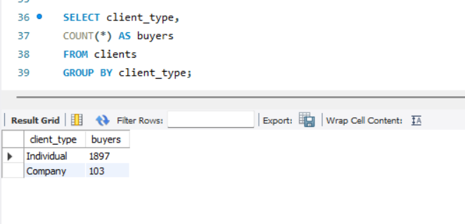
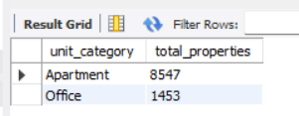
7.SQL Analysis
b. Loan Analysis
e. Acquisition Purpose Analysis
a. Country wise Buyers
c. Average Satisfaction Score
f. Total Client Type Analysis
d.Category-wise properties

Slide 9
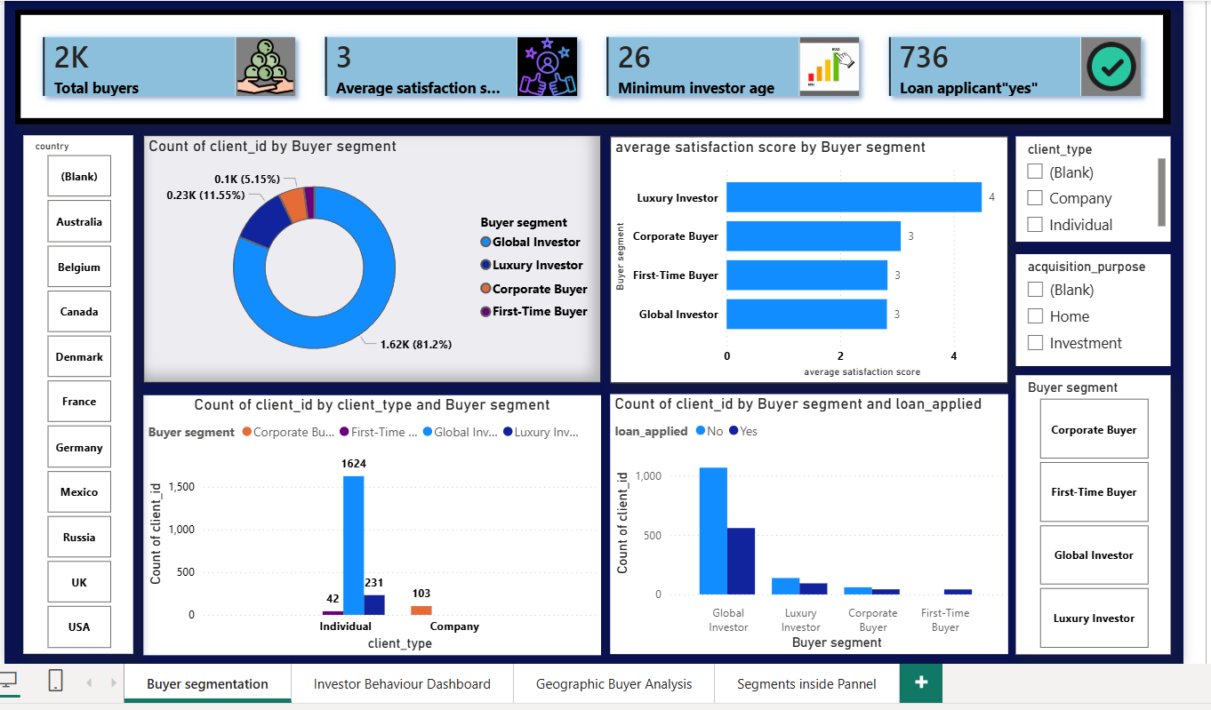
8.Dashboard Development
Module 1: Buyer Segmentation Overview

Slide 10
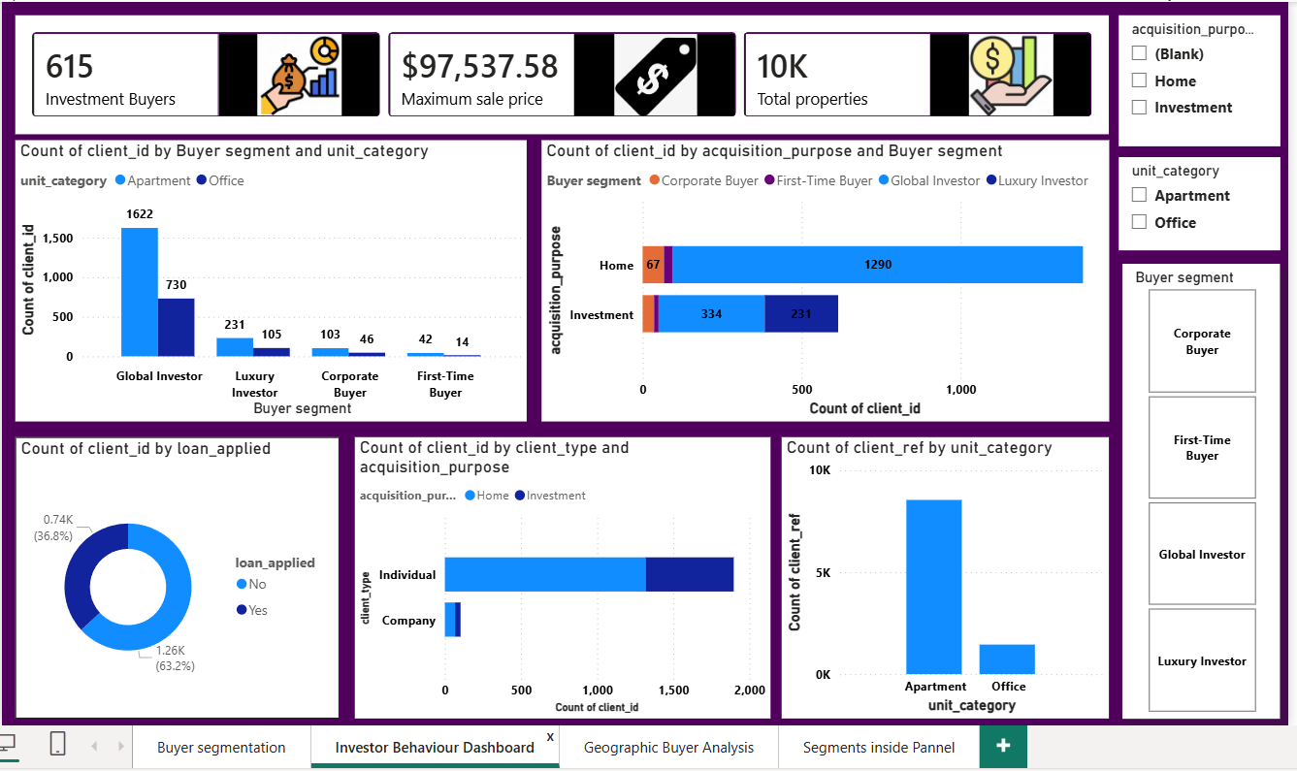
Module 2: Investor Behaviour Dashboard

Slide 11
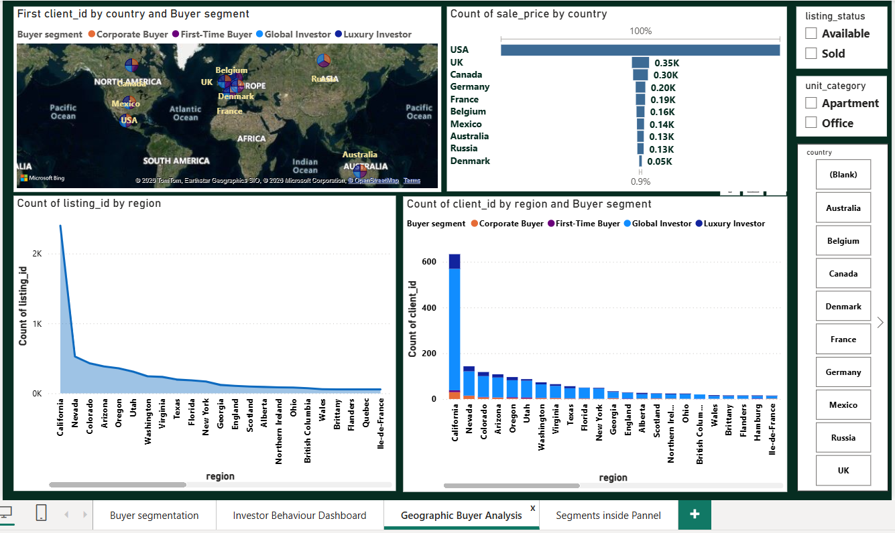
Module 3: Geographic Buyer Analysis

Slide 12
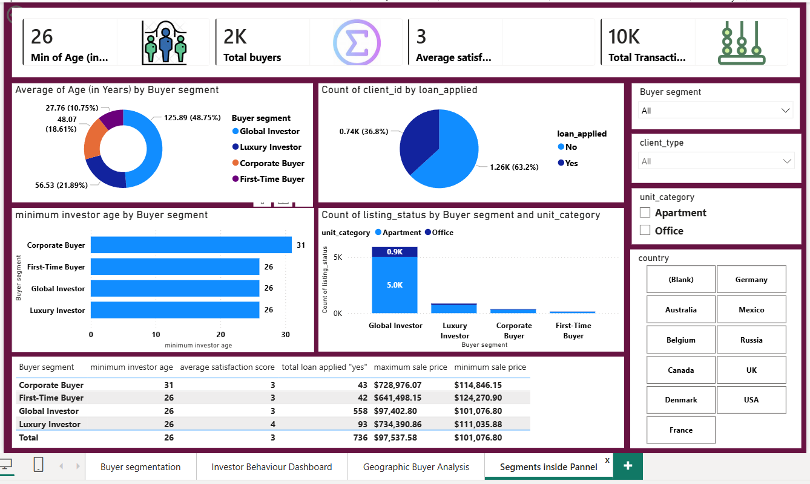
Module 4: Segment Insights Panel

Slide 13
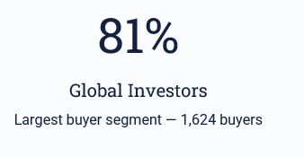

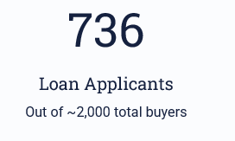
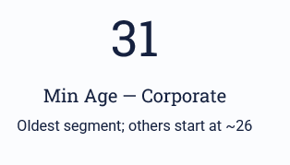
9.Key Findings
(A) Segments & Satisfaction

Slide 14
(B) Property and Geography
Property Insights:
Geographic Insights:
Apartments most preferred property type
Individual buyers dominate over corporate
Investment purchases concentrated among Global & Luxury Investors
Global Investors hold the largest number of properties
California — highest buyer & listing concentration
USA — highest total property sales value

Slide 15
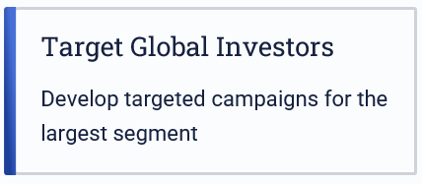
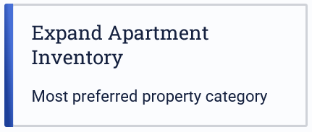



10. Recommendations

Slide 16
11.Conclusions
Buyer segmentation techniques were used to classify customers into Global Investors, Luxury Investors, Corporate Buyers, and First-Time Buyers. Interactive dashboards were developed to analyse buyer demographics, investment behaviour, geographic trends, and segment-level insights.
The analysis revealed that Global Investors form the largest buyer group, apartments are the most preferred property type, and California is the leading region in terms of buyer activity. The dashboards provide actionable insights that can help real estate organizations improve customer targeting, optimize investment strategies, and support data-driven decision-making.

